Slide 1
SYSTEC EGY
Company profile

Slide 2
Index
About us
Vision & Mission
Company History
Services
Automation System
Vendors
Contact us

Slide 3
ABOUT US
Welcome to SYSTECEGY
IT Solutions for Business
SYSTECEGY is an IT service provider & Innovation located in Egypt specialized in designing, implementing and maintaining IT infrastructure targeting Middle East market, we provide reliable IT infrastructure supporting business demands and profitable IT business solutions.

Slide 4
WHY CHOOSE US
Modern Technology to Improve Your Business
Our Vision
With the collaboration of our work, development and business, we are always at the cutting edge of the latest technologies. The integration of information and communication technology has become an indispensable part of our daily lives.
Our Mission
We are a company that provides the best quality of products with the highest level of support in order to reach customer satisfaction. We have professionally qualified engineers that will be able to answer any question or concerns you may have.Our Services and infrastructure solutions. Will offer the most dependable services, committed to deliver the very best, on time and within budget.

Slide 5
Success Partners

Slide 6
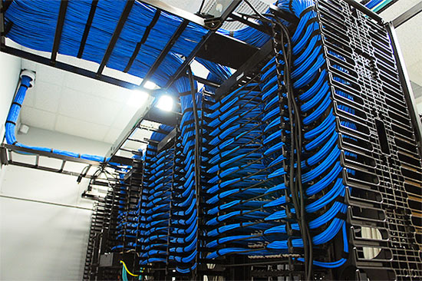
Services
Structured Cabling
Services
SYSTECEGY is specialized in data and fiber optic cabling installation and testing supported reliable, high-quality, standards-based cabling and network infrastructure components, implementing new or upgrading current infrastructure, SYSTECEGY provide a network cabling system that's able to scale accommodating bandwidth needs and simply integrate the newest technologies helps your business stay competitive while reducing overall infrastructure costs .

Slide 7
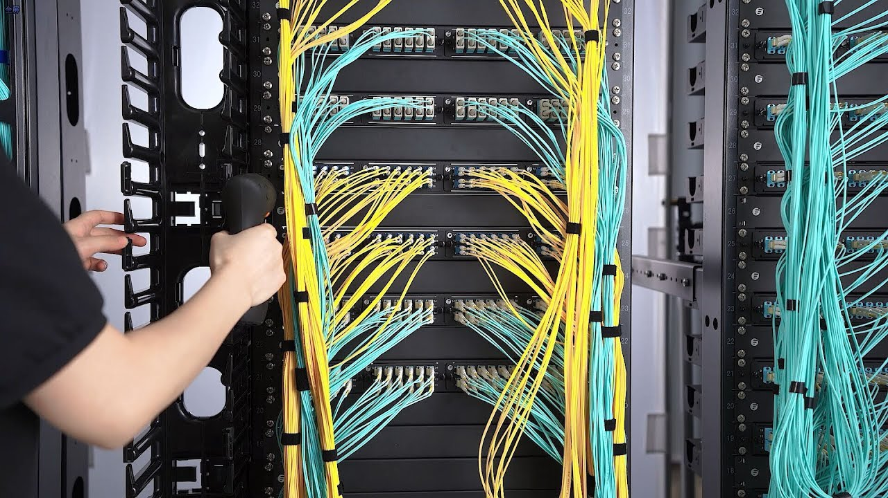
Services
Copper and fiber cabling
SYSTECEGY is committed to providing their clients the latest Structured Cabling Systems, such as, CAT5E, CAT6, CAT6A, CAT7 single mode and multi mode cable systems that are capable of Gigabyte speeds and more. SYSTECEGY provides their customers and business partners with the greatest amount of functionality through ANSI, TIA/EIA and ISO Standards .

Slide 8
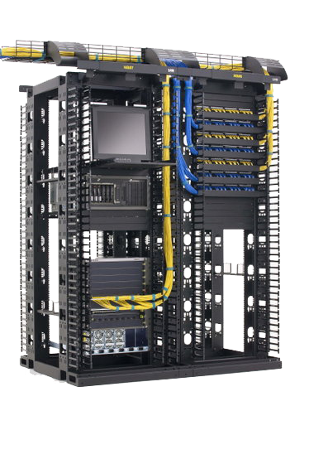
Services
Network Cabinet
Because Network Racks are an important component of the structured cabling systems,
SYSTECEGY provides a network cabinet which can efficiently and safely hold all network components, efficiently utilizing the space in your data center. SYSTECEGY have well trained technicians working with various types of racks including “Floor mount, Wall mount, Network Racks, Server Racks”

Slide 9
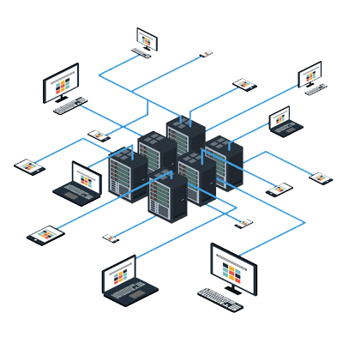
Services
Network Infrastructure
SYSTECEGY covers all of your needs when it comes to planning, building, or upgrading your network. We can design and implement various networks from connecting just a few PCs to share the Internet all the way up to connect multiple offices over wide area networks (WANs) using virtual private networks (VPNs). SYSTECEGY offer your organization the ability to secure, manage and share those all-important tools that keep you up and running. Computers, printers, firewall, phones, routers, switches and other digital resources including mobile devices and business applications. Our team specializes in creating and implementing customized networking solutions that are right for your business .

Slide 10
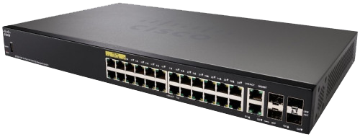
Services
Routing & VPN
SYSTECEGY MPLS & 4G VPN services enabling you to gain the full benefits of a flexible, connected business. We converging voice, data and multimedia traffic onto a single, secure network .
Managed Switches
SYSTECEGY Managed Switch installation service addresses the growing importance of LAN reliability to your business as the LAN performance and security is the most significant part of your network. SYSTECEGY builds a promising switching infrastructure support Data, Voice, and Video traffic with effectively used bandwidth through 100/1000 and 10G switches .

Slide 11
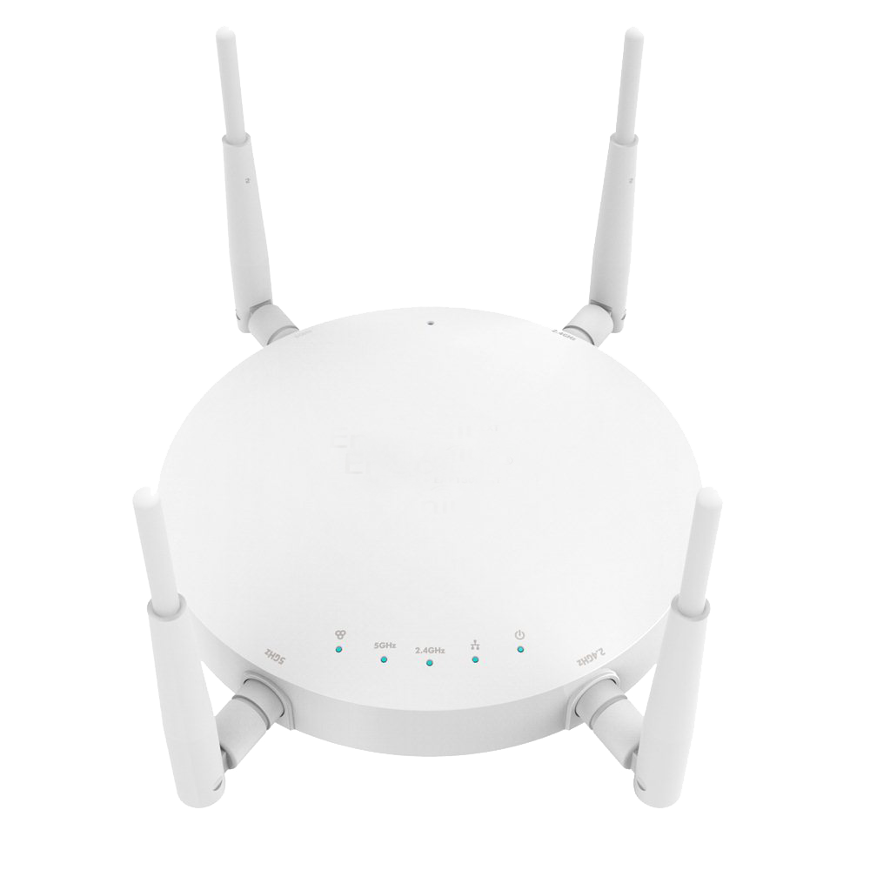
Services
Wireless
SYSTECEGY transforming business into mobility providing employees with the tools to communicate and collaborate anywhere, any time. We brings wireless networking to high traffic public areas such as airport terminals, convention centers, hotels, shared offices, manufacturing facilities, warehouses, auditoriums and classrooms With 802.11 a/b/g/n POE high performance access point and controllers.

Slide 12
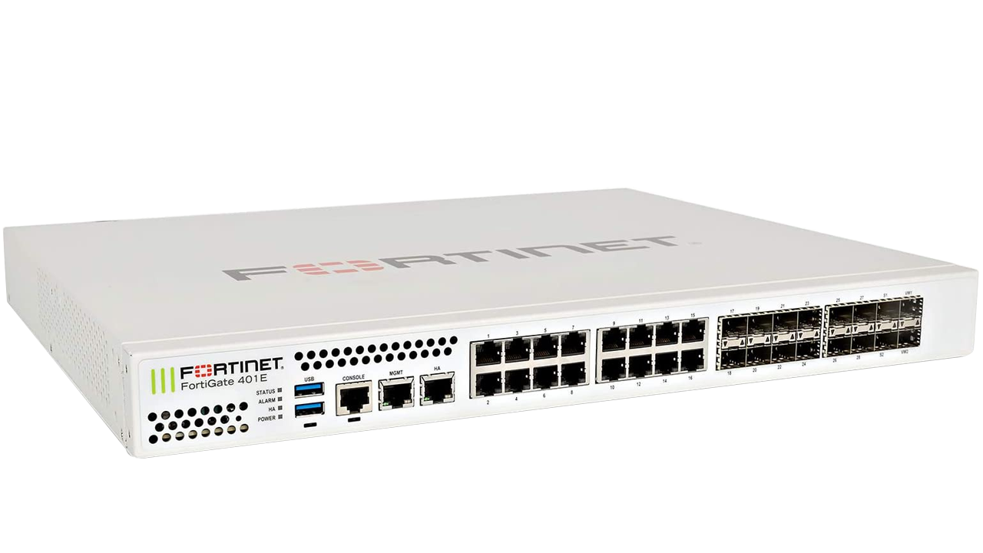
Services
Security
Firewall:
SYSTECEGY Keeps your data, your hardware and your employees safe from unwanted attacks with network firewall, IPS, IDS, DoS design and implementation services from Fortinet, Cisco and Microsoft. Our professionals create a unique design and firewall implementation plan for each company we work with and then provide complete implementation services as well as hardware maintenance and software support .

Slide 13
Services
Servers and Storage Deployment
Standard Installation
Remote Deployment
Rely on our on-site experts to deploy and configure your hardware, and install operating systems.
Taking a bonus of remote deployment for brand new or existing servers and storage. Through a secure Internet connection, we will remotely configure your new hardware to precise specifications. This service is a cost-effective and efficient thanks to integrate new hardware into your environment .
Rack Integration
e can rack and cable your new server and storages products on-site or in our company prior to shipping. Your new systems will be ready for integration into your environment .

Slide 14
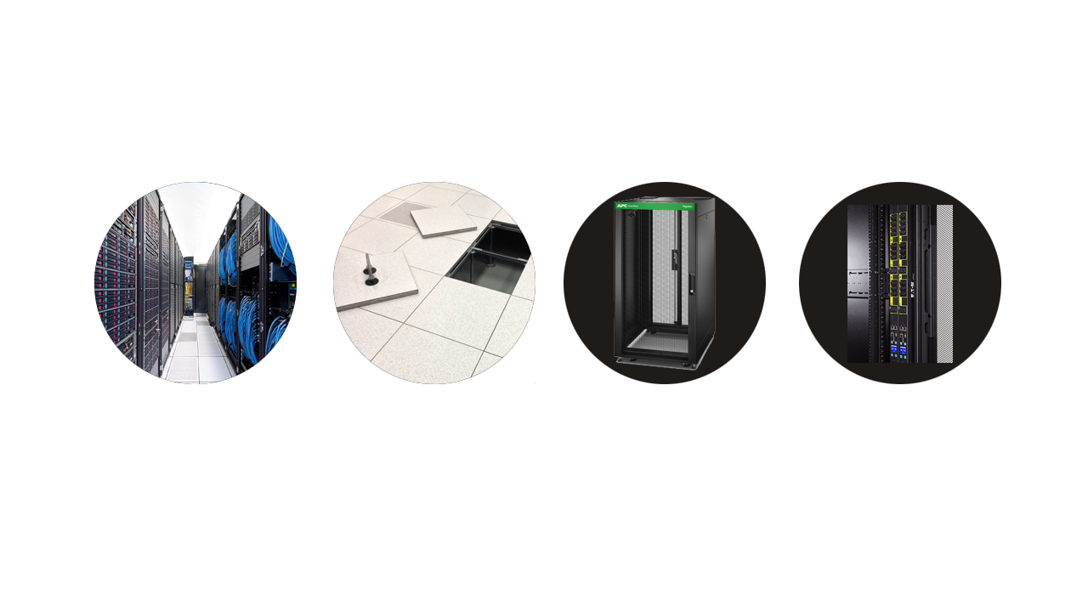
Services
Data Center Solutions
Developing a secure, reliable, and efficient data center is a top priority for IT professionals. Whether upgrading its current data center infrastructure or designing a brand new data center from scratch, SYSTECEGY expertise can help your company move from the design stage through implementation and maintenance. A data center should function as a carefully controlled environment. Choice of location, cooling, and the amount of space required, and the related power requirements are all important factors that require to be considered when building a data center. SYSTECEGY team of experts is trained to assess these factors and more to design any kind of data center perfectly suited to your needs. When it comes to providing scalability, flexibility, and high availability, our designs and resources set SYSTECEGY one of the most effective. Our team of system engineers and power/cooling experts has the extensive industry knowledge, and that we can engage on an engineer-to-engineer basis to design unique solutions optimized for your business.

Slide 15
Services
Key Design Criteria
Environmental Specification
Power Distribution Systems
Accurate Documentations
Raised Floor, Cable Trays
Surveillance systems
Data Center,
Cooling solutions
UPS

Slide 16
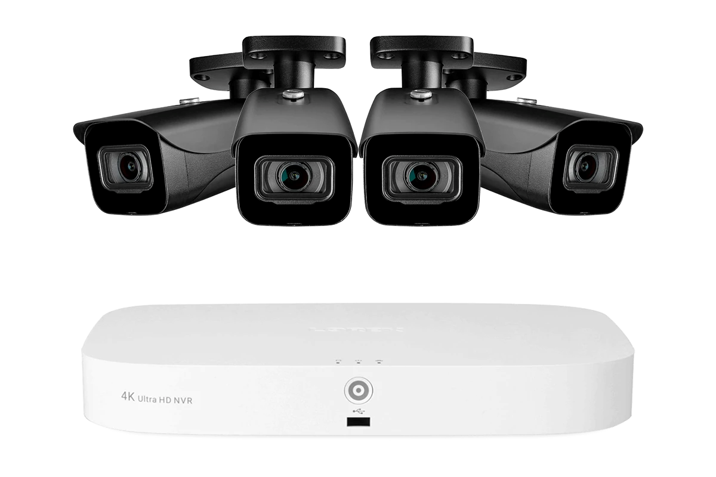
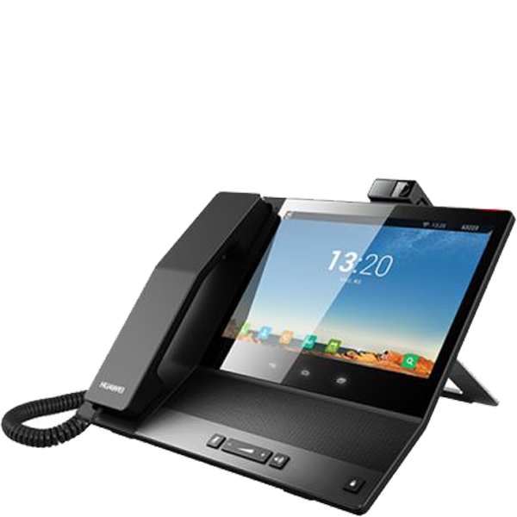
Services
Surveillance systems & Access Door
The increase in criminal damage and theft in recent years has seen the most reason for the installation of CCTV security systems. SYSTECEGY offers a wide range of surveillance CCTV security systems that are designed to suit almost any application requiring a view of a given location and we have the ability to specify the latest in camera design and operation. SYSTECEGY can deliver an integrated CCTV solution for any challenge you may face, from single cameras to multi-level surveillance and remote management. In the area of Security Access Control you will find that SYSTECEGY are fully prepared to provide all access control systems and deceives beside providing the operating systems and linking them to main server that make attendance process run so easy
VOIP
SYSTECEGY with its partners will consult, recommend and implement a VOIP technology that allows your business to cut telecommunications costs, while improving functionality. VoIP phones can be used anywhere and anytime, provided there is a broadband connection available. It's the simple, affordable way to communicate from - and to - anywhere in the world.

Slide 17
Services
Retail Solutions
The retail industry is facing challenges similar to those in other industries. The only difference is that customers can combine together to put a great deal of pressure on retailers SYSTECEGY staff have over 14 years of experience in IT retail industries in well-known companies, Today SYSTECEGY is a leader in Retail POS as an experienced consultant of Point of Sale Systems as well as individual point of sale peripherals for a wide range of business environments. Now we provide our clients with a complete range of solutions including software, hardware, support and infrastructure. Today we are engaged in every aspect of technology in retail leading us to provide retail turn-key solution .
Project Management and Consulting
IT
Power Solution
When the project time-line may be a concern, there is no margin for errors. you need your network installation finished on time and within budget. And none is more committed to making that happen than your SYSTECEGY project manager. While others may view obstacles and setbacks as excuses for delay, our project managers understand navigating these challenges is just part of their job. They use the latest tools, technology, and a dose of creativity to keep your project on schedule and your business goals on track. And by anticipating problems before they arise, many would-be issues never even surface. SYSTECEGY network consulting services begin with you, your needs, your objectives, and your budget. Our experts take the time to understand your goals with a complete needs assessment. During our site survey and visits, we work cooperatively with your on-site staff to ensure communication. Then, we design a plan that reflects your objectives and works with your budget.
SYSTECEGY a premier partner for APC Schneider Electric We can provide many scales UPS’s Home use to large size ( data center UPS) provide a full support and technical advice with service level agreement (SLA) service contract and after sales activities including Schneider Electric warranty. also SYSTECEGY have a team equipped with the highest certificates in the field of energy to deal with all kind of UPS’s and analyze a site and give the necessary advice to the customer with regard to the appropriate cost of the project .

Slide 18
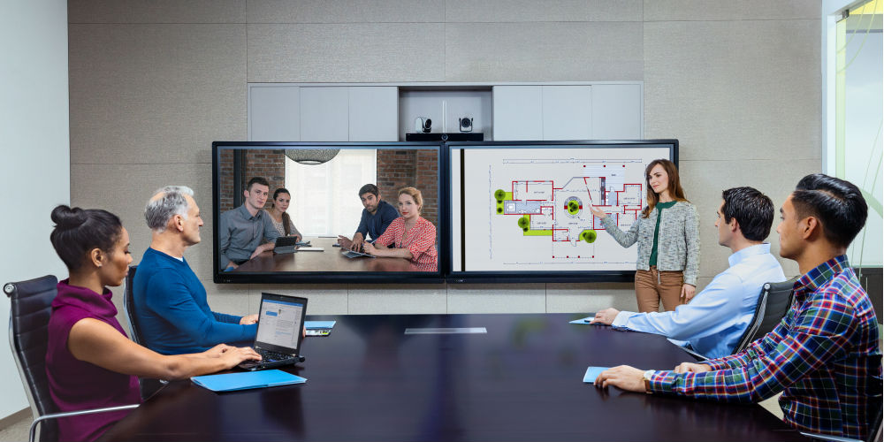
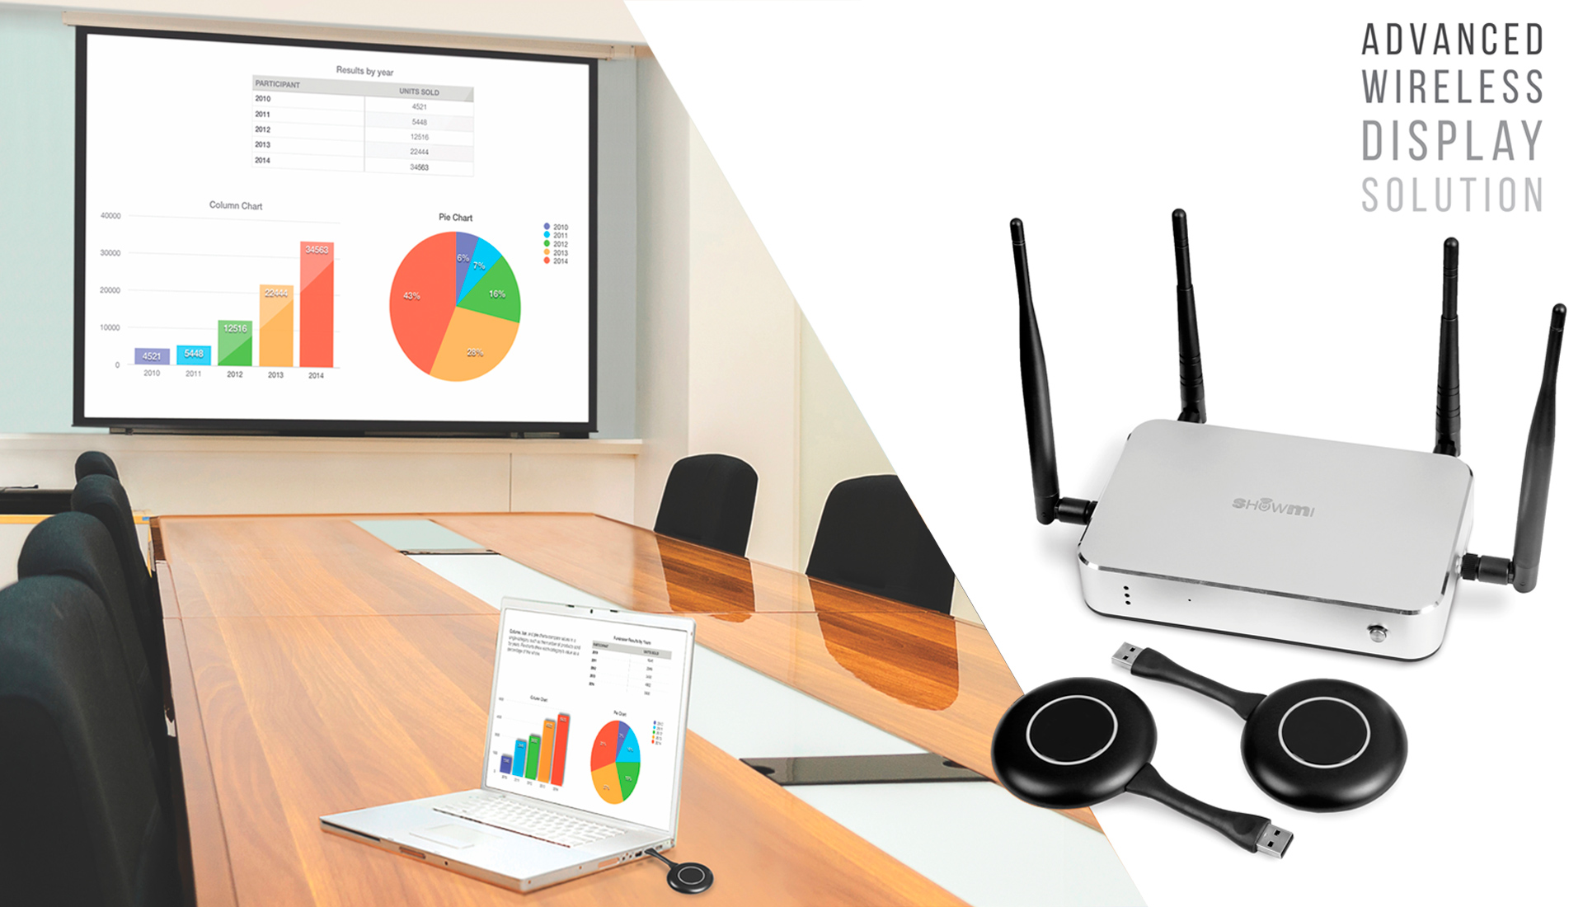
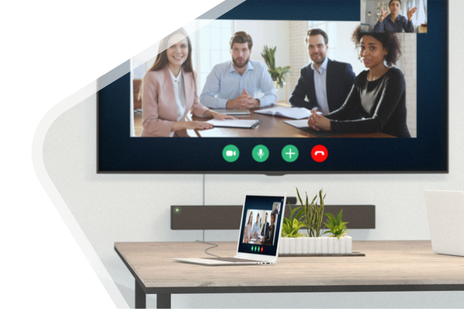
Services
Conference Solutions
- Voice Conference - Video Conference - Call Center - VOIP System - Wireless Presentation
SYSTECEGY provides integrated voice transmission systems, VOIP systems, and network solutions to help you better handle your business operations, We take a personal approach in getting to know your business as if it were our own .

Slide 19
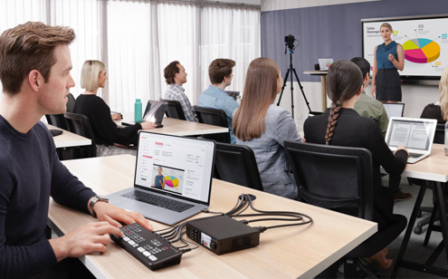
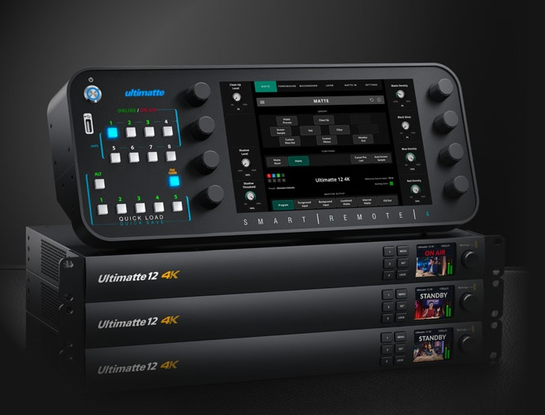
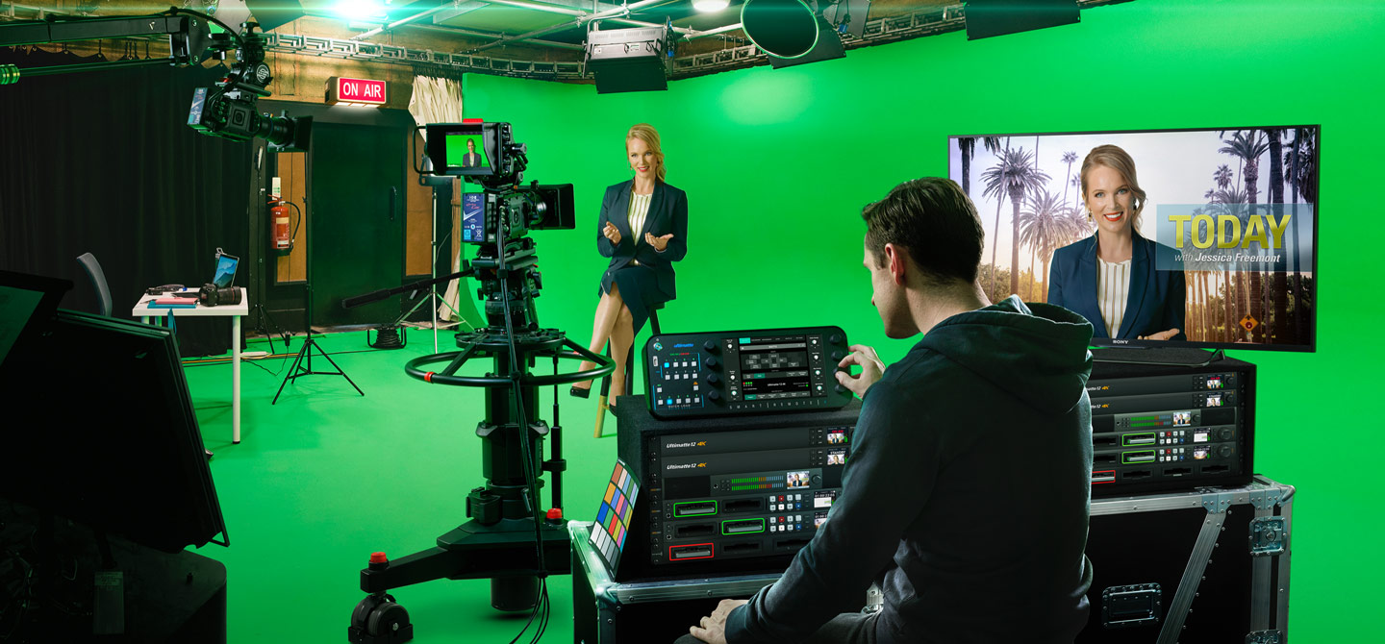
Services
Broadcasting Solutions
SYSTECEGY Design is dedicated to allowing the highest quality video to be affordable to everyone, so the post production and television industry can become a truly creative industry.

Slide 20
Services
Microsoft Dynamics 365 Finance and operation
Dynamics 365 Finance and Operations is an Enterprise Resource Planning (ERP) system that helps medium to large-sized businesses to automate and manage their operations. It offers real-time visibility to improve decision-making, and project outcomes, and foster business growth.
Whether you’re in the manufacturing, service, or wholesale industries, Microsoft Dynamics 365 Finance, and Operations can help you locate the industry-specific, custom solution you need to manage and improve core business functions.

Slide 21
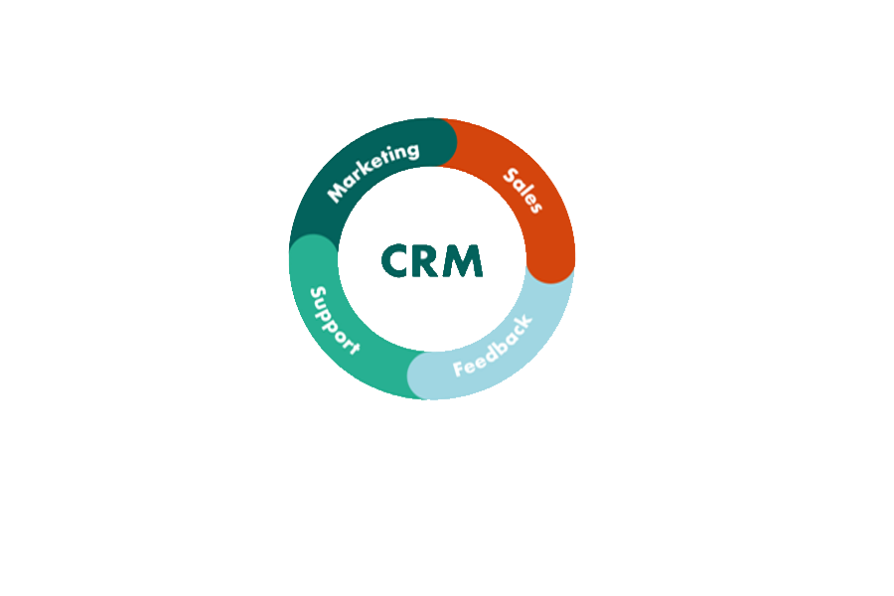
Services
Microsoft Dynamics 365 CRM
Customer relationship management (CRM) is a tool used for managing all interactions and relationships between your company and customers and potential customers. You can use CRM software to keep track of interactions, data, and notes about customers to improve customer service relationships and boost customer retention rates and drive sales growth.
Microsoft Dynamics 365 Business central
Business Central is a cloud-based, all-in-one system with built-in business integration that provides a single complete solution to fulfill your expanding business’s demands. Microsoft Dynamics 365 is an integrated ERP solution that dynamically connects systems and processes together to manage financial sales, services, and operations.
Dynamics 365 Business Central is the perfect solution for organizations that have grown beyond their traditional management solutions, and are ready to adopt a solution that will make them more effective, agile, and profitable

Slide 22
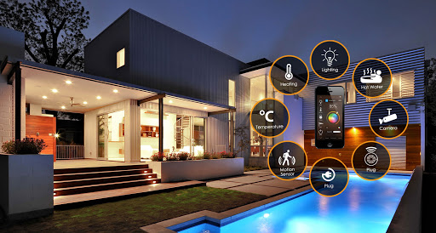
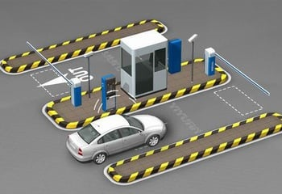
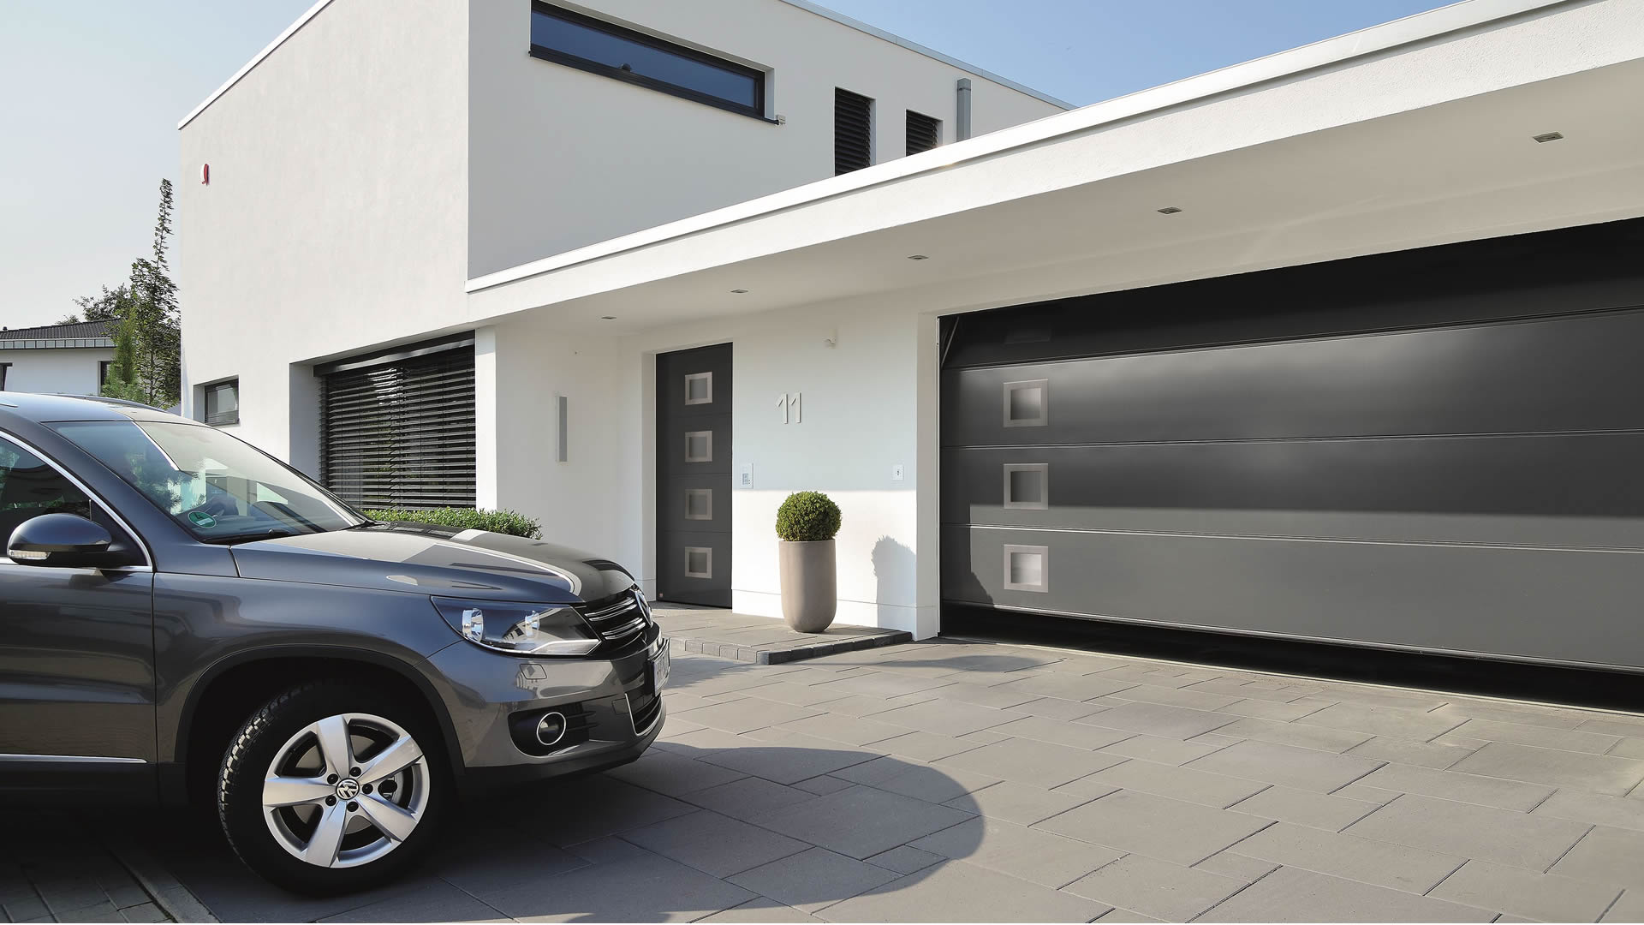
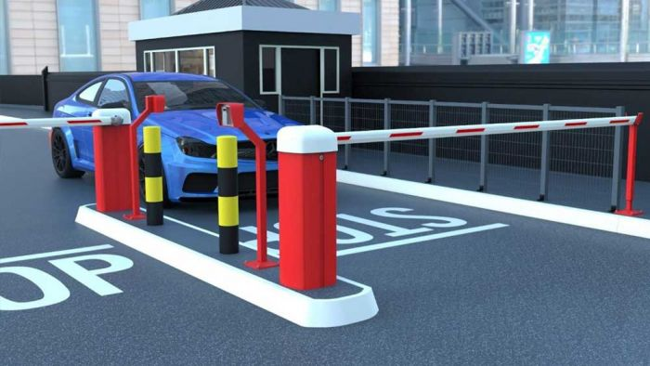
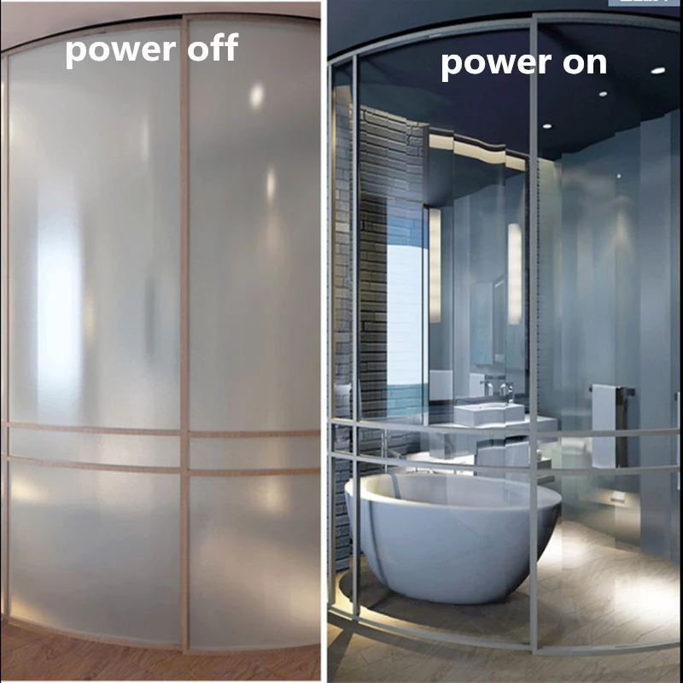
Services
Automation Systems
All-In-One Smart Automation for homes, industries and commerce
Smart Home
Traffic control
Access Control
Automatic Gates
Parking System
Smart Windows Film

Slide 23
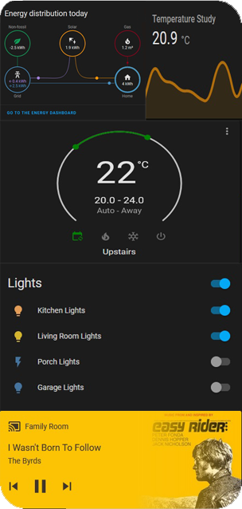
Services
Automation system
Smart System
Control anything in your home or office from any location
SYSTECEGY mission is to make Smart Home easy and accessible for everybody. We offer Top Services for every aspect of our customers journey with the most important decision in transforming their Homes! ​ From the start of choosing the right solution, platform or just comparing products features, our Experts will be there for you by Phone, Video call or onsite!
Smart App
Compatible with
IOS / Android / Windows

Slide 24
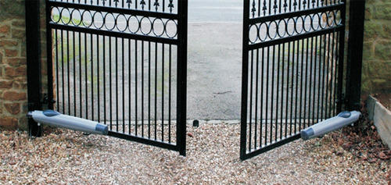
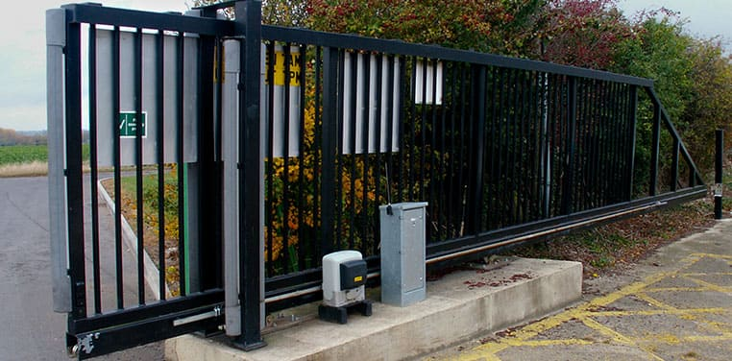
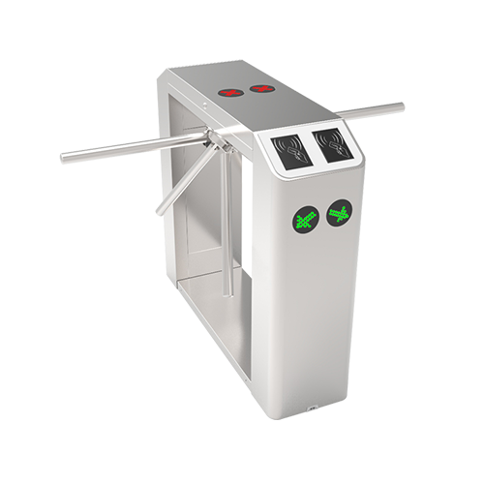
Services
Automation System
Swing
Sliding
Automatic Gates
Automatic Doors
High Speed
Tumstile
Sectional Doors
Rolling

Slide 25
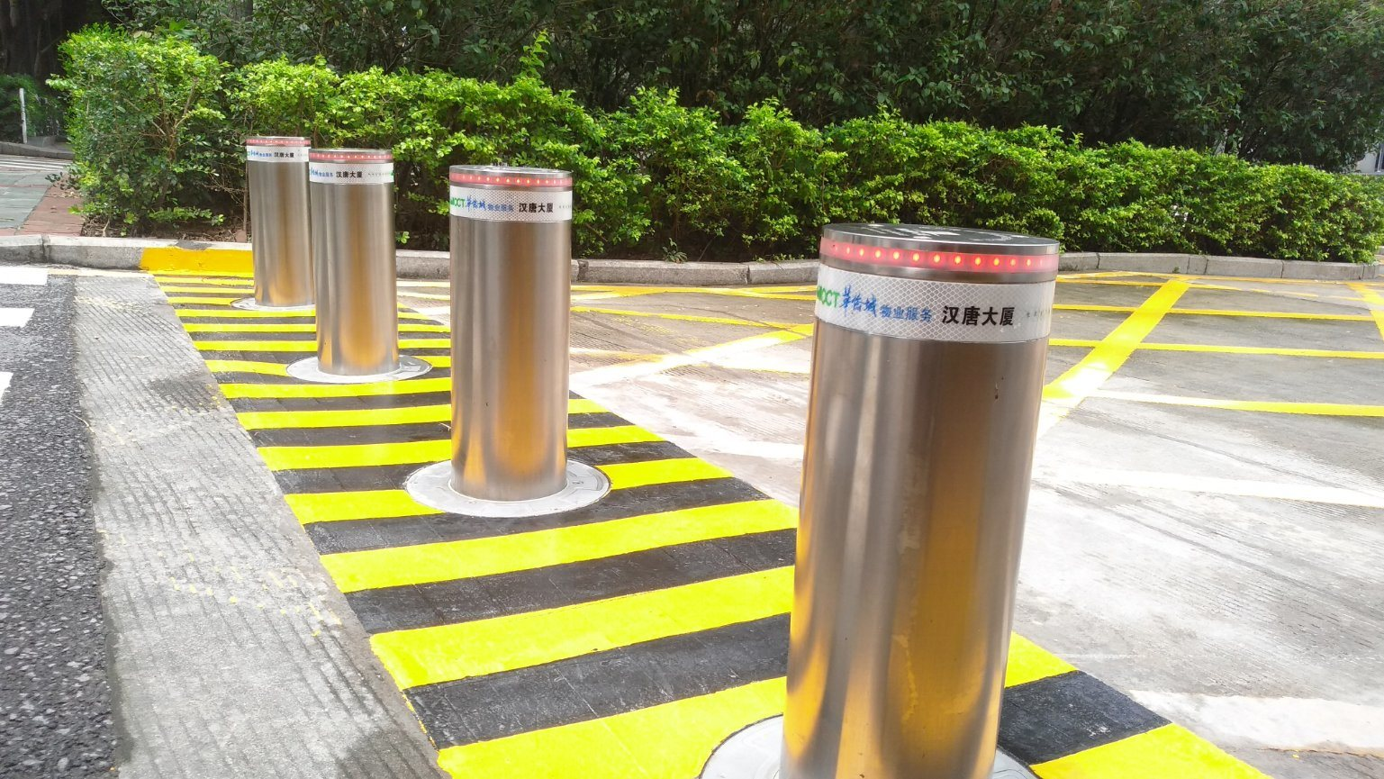
Services
Bollard
Automation System
Traffic Control
Barrier

Slide 26
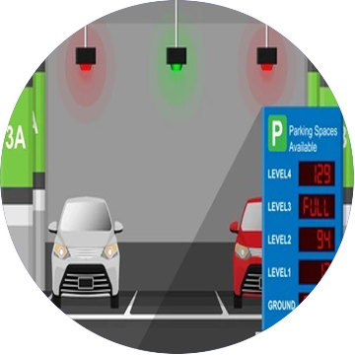
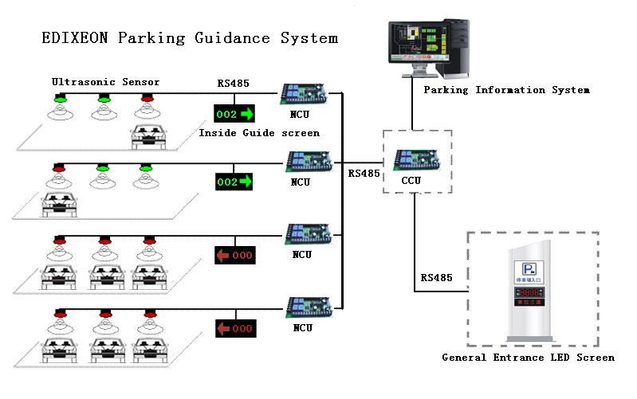
Services
Automation System
Parking System

Slide 27
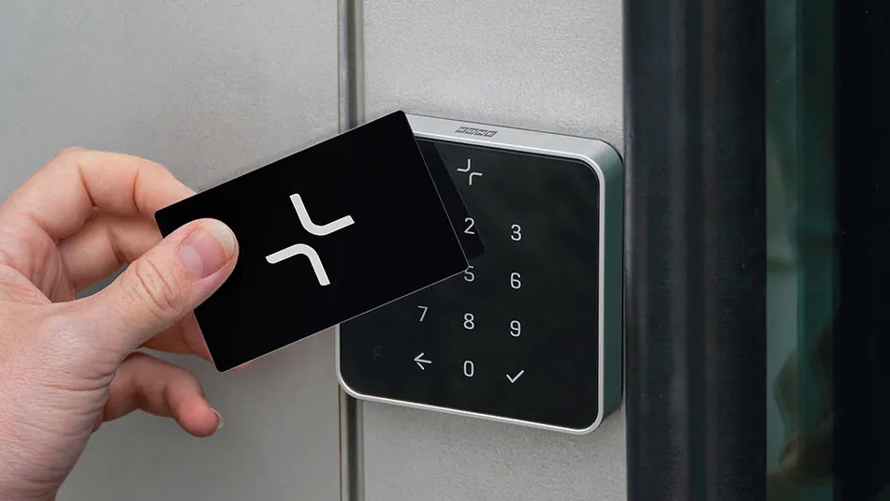
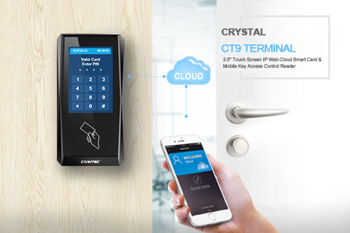
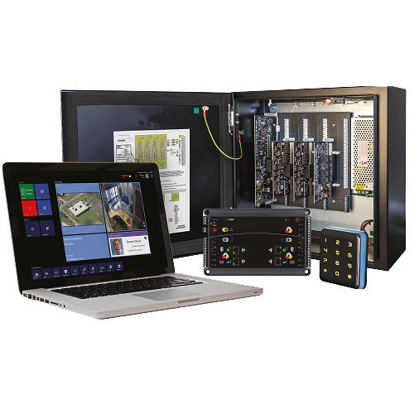
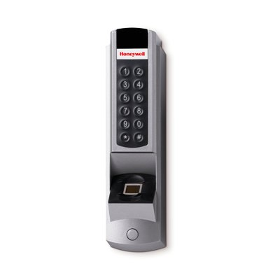
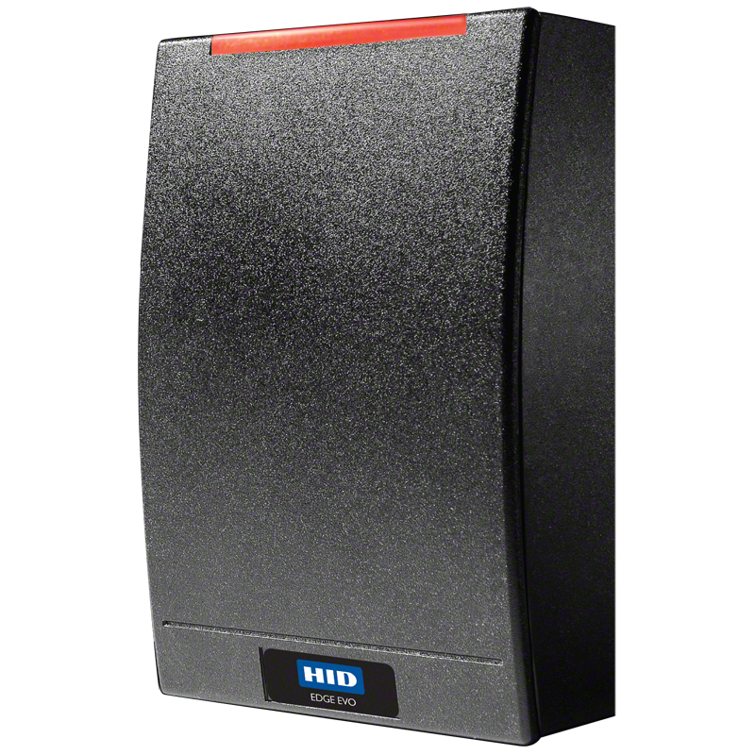
Services
Automation System
Access Control

Slide 28
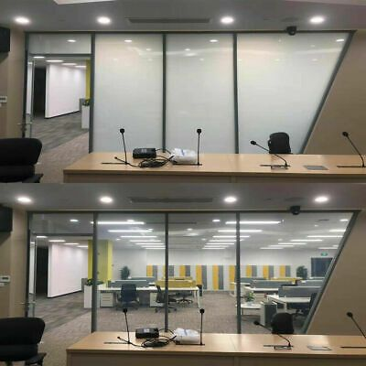
Services
Automation System
Smart Windows Film
Smart Window Film has been upgraded with the latest PDLC (polymer dispersed liquid crystal) technology that provides 90% of VLT which delivers extraordinary viewing experience. It offers a next generation of alternatives to curtains/blinds/shades or privacy film, enable the occupants to be able to control the amount of light / solar heat that enters the building and build a more comfortable environment than ever, and optimize the working/meeting spaces and create dynamic environments that are functional and productive.

Slide 29
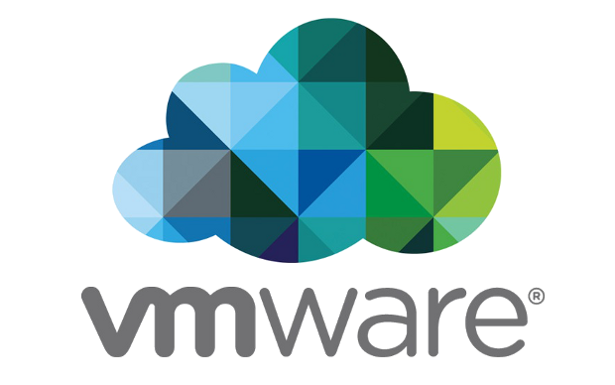
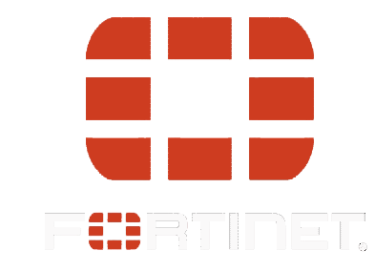
Vendors

Slide 30
Contact US
info@systecegy.com
01211108719 – 01015561193 - 01140400608
www.systecegy.com
100 Al-Merghany St, Floor 4, Cairo

Slide 31
SYSTEC EGY
Thanks

